Slide 1

Predicting customer buying behaviour.
03/06/2024

Slide 2
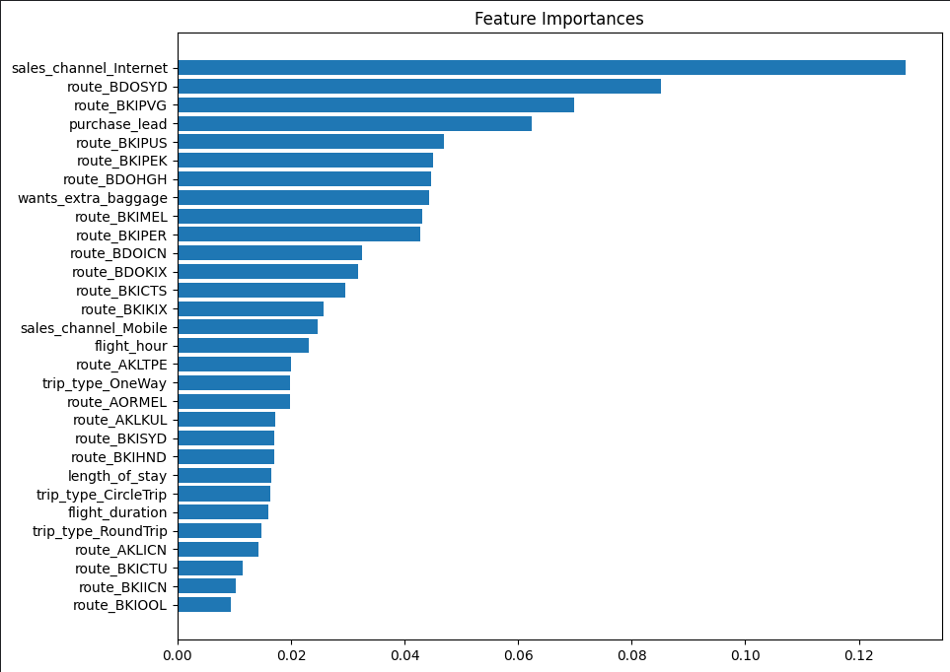
Predictive model to understand factors that influence buying behavior.
Data Analysis and Model Training with Random Forest Classifier: Achieving.
MODEL ACCURACY 88.01%
PRECISION SCORE 91%
RECALL SCORE 87%
AUC SCORE 0.95%
Precision Score: In the Above Score We predicted actual completed bookings out of all Successfully completed bookings. 91%.
Recall Score: Chance of predicting actual true successful bookings 87%.
AUC score: helps to understand model ability between Positive and Negative classes. If AUC score between 0.9 to 1.0 model has excellent performance Nearing Perfect Classification.
Maximum Booking Not Completed in Australia and Malaysia very few booking completed on Australia Malaysia and other Countries.
Maximum flight departure times are between 8 and 12.
The minimum number of days between travel date and booking date is 1 to 13, and rest of the people maximum between travel date and booking date is 50 to 60 days.
89% booking has been done through Internet. mostly people prefer internet as compared to Mobile.
40.80% bookings have come from Australia and 14.82 bookings have come from Malaysia and 10% booking from South Korea.
The maximum people prefer to book their seats from Internet and maximum Booking done in Australia and Malaysia from Internet.
Top Features that can drive successful Flight Booking.
Notes:
British Airways

